Slide 1


Slide 2
WINDFOR’S Status report
Digital team
Boris Ostaev
2015

Slide 3
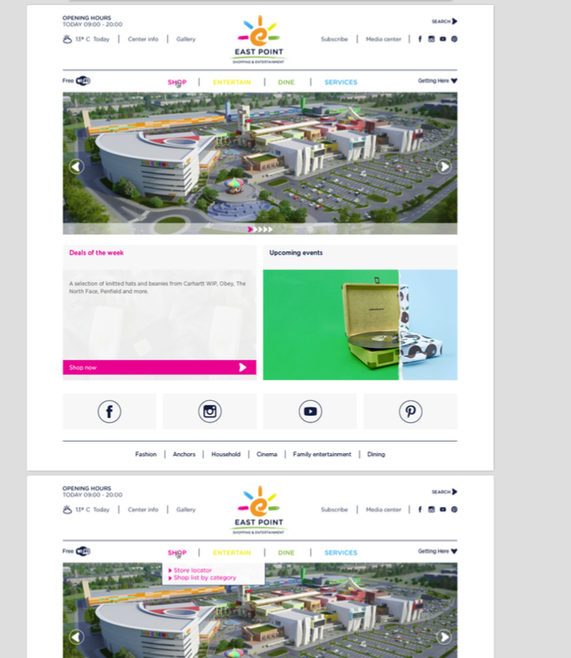
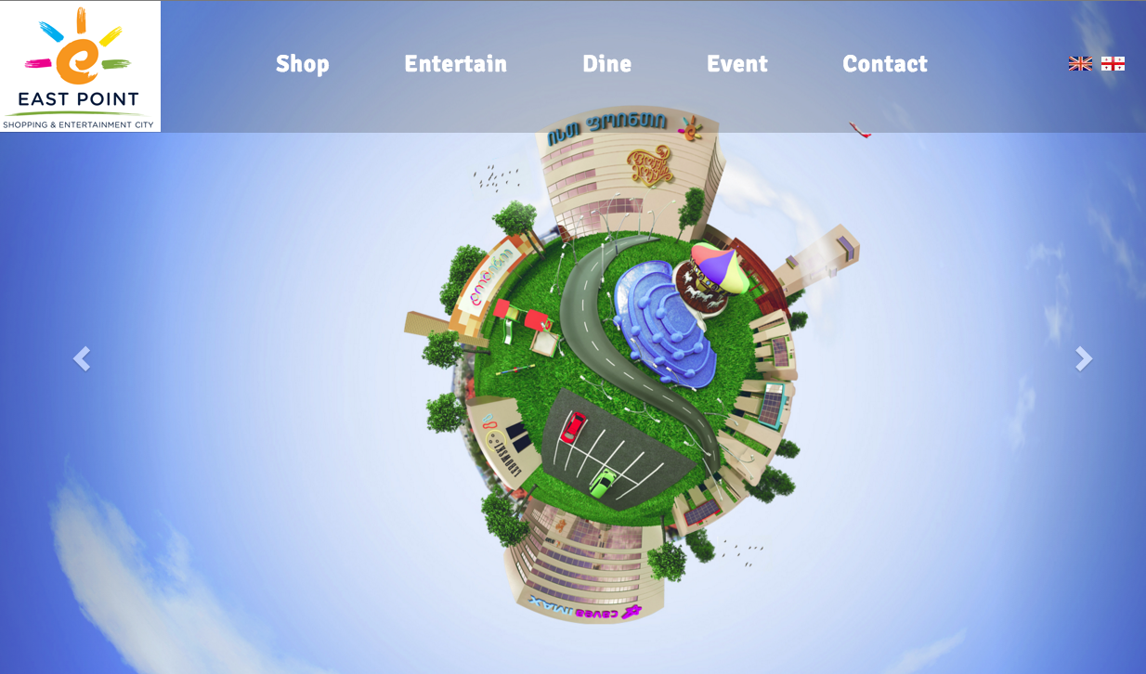
Project - 1
Name: East Point Url: www.eastpoint.ge Designer : 1- unknown 2- Zaza account : Dima
Type: Website

Slide 4
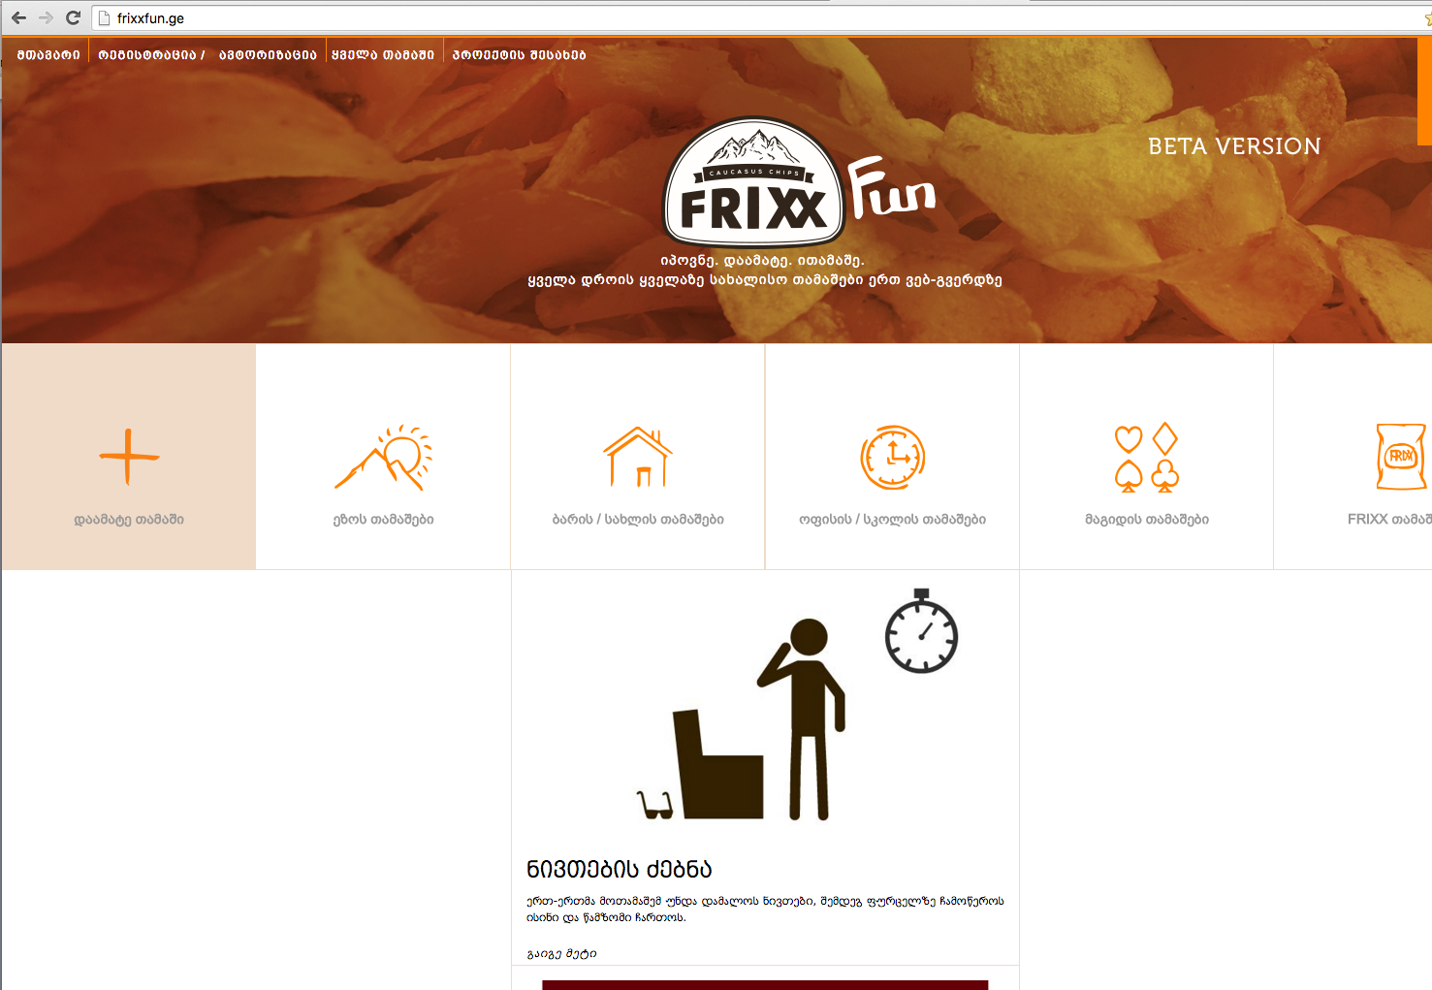
Project - 2
Name: Frixx Fun Url: www.frixxfun.ge Designer : tamta account : Tamo
Type: Website

Slide 5
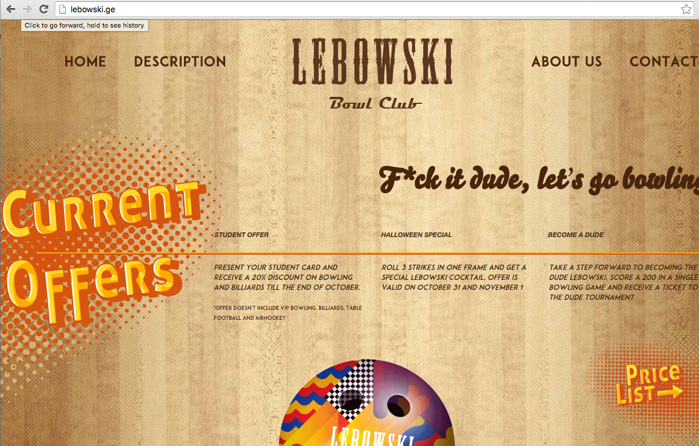
Project - 3
Name: Lebowski Url: www.lebowski.ge Designer : tamta account : Dima
Type: Website

Slide 6

Project - 4
Name: caucasus Url: -- Designer : Ruslan account : Tamo
Type: FB APP

Slide 7
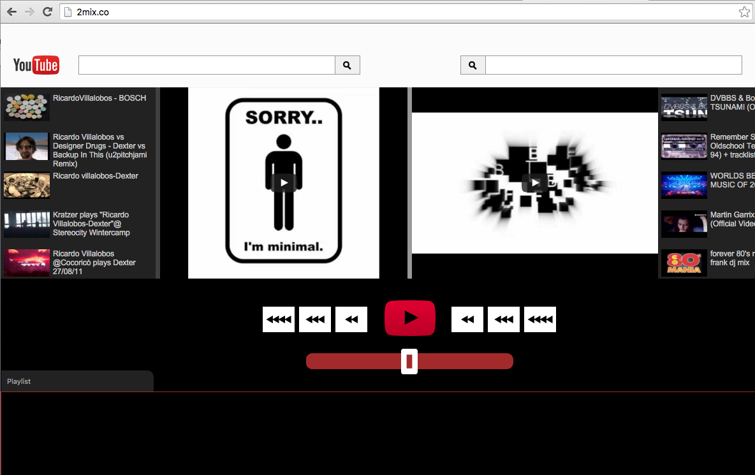
Project - 5
Name: 2MIX.ME Url: www.2mix.me Designer : Nika account : Bibi
Type: Web APP

Slide 8
PROBLEMS
Task Problem
Technical Problem
East Point
Lebowski
East Point
Lebowski
co-ntest
Design Problem
Lebowski
East Point
Frixx Fun

Slide 9

RECOMENDATION
Task Management System : www.trello.com
Version Control System : www.github.com
Local blog for web design
A detailed technical description (For each Project)
Small Digital Lab
6. Arranged work hierarchy (Team)
https://trello.com/b/vLgSzsvW/windfors

